Slide 1
Project Presentation of CO-OP Project at Industry (Module-2) (22CS421)
On
Product Data Management
Aditya Sharma – 2210992588
Ishaan Singla – 2210992582
Shreyashi Singh – 2210992348
Lakshmesh Sahu – 2210991844
Harshit Sharma - 2210991640
Supervised By
Dr. Isha Kansal
Department of Computer Science and Engineering,
Chitkara University, Punjab

Slide 2
Introduction
In modern enterprises, product information is managed across multiple departments, warehouses, and business applications such as ERP systems, inventory platforms, and supplier databases. Organizations often face problems like inconsistent product codes, duplicate records, and inaccurate product descriptions. These issues affect operational efficiency, reporting accuracy, and overall business performance.
To overcome these challenges, enterprises are adopting Master Data Management (MDM) solutions that help create a centralized and trusted source of information. This project focuses on developing a Product Data Governance framework using Semarchy xDM.
The proposed solution includes features such as data validation, duplicate detection, governance workflows, data standardization, and golden record creation. By implementing a centralized governance approach, the organization can improve data quality, simplify system integration, and support better decision-making across enterprise operations.
2

Slide 3
Problem Statement
Modern enterprises face several challenges in managing product data across multiple systems and departments. These issues affect operational efficiency, data accuracy, and business decision-making.
Inconsistent product codes and descriptions across different systems.
Duplicate product records causing inventory and procurement issues.
Lack of centralized data governance and ownership.
Poor data quality and missing product information.
Difficulty integrating with ERP systems and partner networks.
Manual processes leading to compliance and reporting risks.
Absence of a single trusted source of product data.
3

Slide 4
Proposed Solution
The proposed solution is to implement a centralized Product Data Governance system using Semarchy xDM to manage and maintain accurate product information across the enterprise.
Build a centralized product data governance system using Semarchy xDM.
Standardize and clean product data to ensure consistency across all systems.
Implement duplicate detection and creation of a single golden record.
Use governance workflows for approval, ownership, and data control.
Enable integration with ERP and other enterprise systems through APIs.
4

Slide 5
Execution Of Project
Semarchy xDM (Intelligent Data Hub) – For data modeling, mastering, and creating golden records.
Source Systems (Flat Files / Databases / APIs) – For importing raw data.
SQL Database (e.g. PostgreSQL) – For storing and managing source and mastered data.
Excel / CSV Files – For initial data preparation and testing inputs
Web Browser (Semarchy Web UI) – For configuration, matching rules, and validation.
Data Quality Rules Engine (inside Semarchy) – For validation and standardization of data.
5

Slide 6
Key Learnings
1. Master Data Management (MDM) Concepts
Understood the fundamentals of Master Data Management, including how organizations maintain a single, consistent version of critical business data across systems.
2. Semarchy xDM Platform Usage
Gained hands-on experience with Semarchy xDM for building data models, configuring entities, and managing data mastering processes through its web-based interface.
3. Data Modeling and Entity Design
Learned how to design logical data models by defining entities, attributes, relationships, and hierarchies to represent real-world business data effectively.
4. Data Matching and Deduplication
Understood how matching rules work to identify duplicate records and how survivorship rules help in selecting the most accurate and reliable data.
6

Slide 7
Some More Key Learnings
5. Data Quality Management
Learned how to apply validation and standardization rules to ensure data accuracy, completeness, and consistency before and after loading into the system.
6. Data Integration Process
Gained knowledge of integrating multiple source systems (files, databases, etc.) into Semarchy xDM for centralized data management and consolidation.
7. Golden Record Creation
Understood the concept of creating a single “golden record” by merging multiple source records into one trusted version used across the organization.
7

Slide 8
Advantages
Improved Data Accuracy : Ensures clean, validated, and standardized data by removing duplicates and inconsistencies.
Single Source of Truth : Creates a unified golden record, providing one trusted version of data across the organization.
Better Decision Making : High-quality and consistent data helps stakeholders make more reliable and informed business decisions.
Efficient Data Management : Centralized data handling reduces manual effort and simplifies data integration from multiple sources.
Enhanced Data Quality Control : Built-in matching, validation, and survivorship rules ensure continuous improvement in data quality.
8

Slide 9
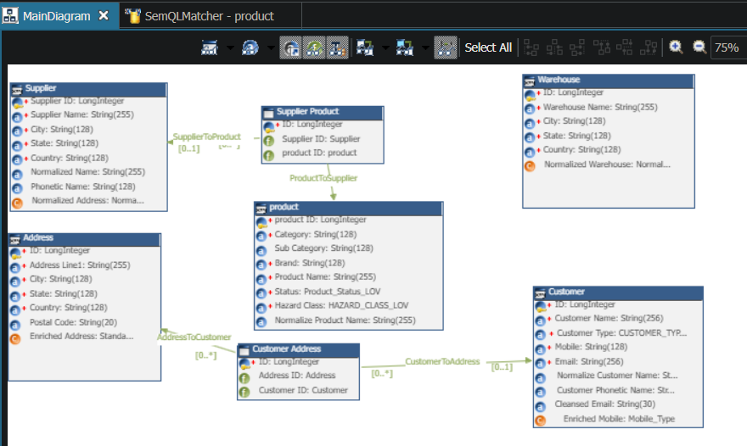
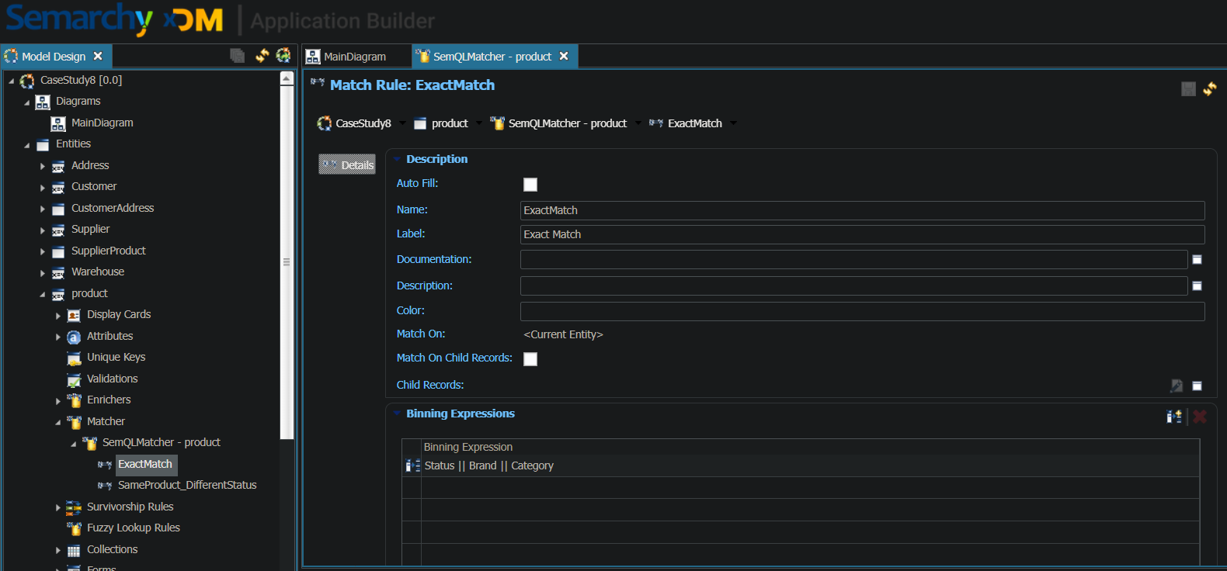
Snapshots
9

Slide 10
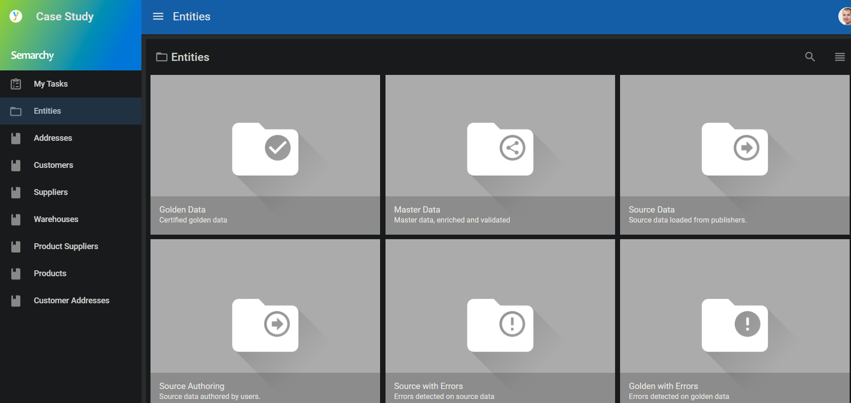
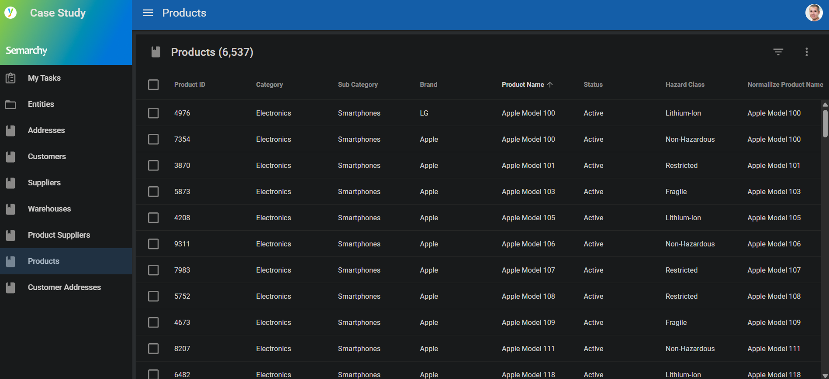
Snapshots
10

Slide 11
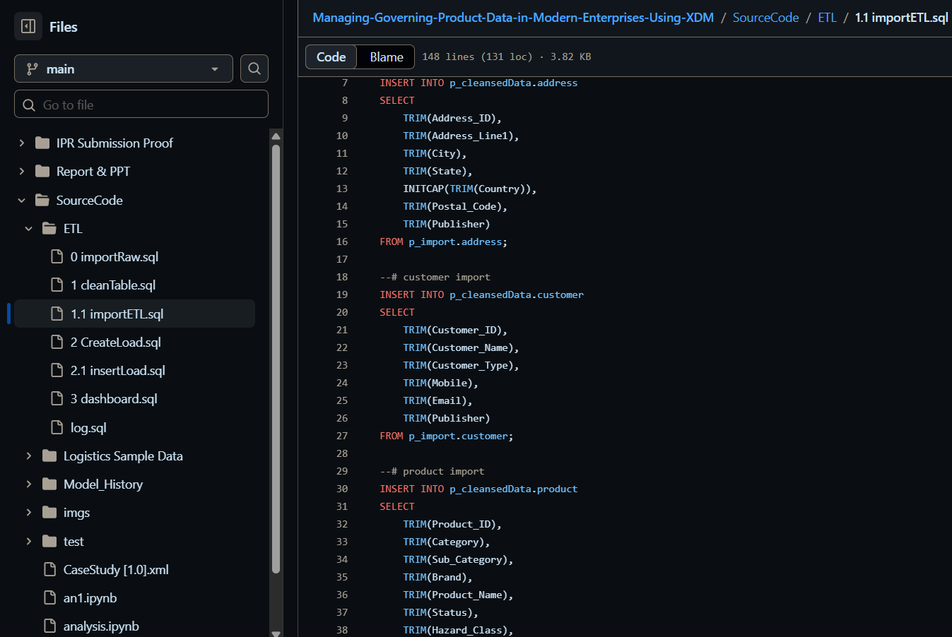
SQL Script
11

Slide 12
Conclusion
Successful Implementation of MDM - The project successfully demonstrated the implementation of Master Data Management using Semarchy xDM.
Improved Data Consistency - It ensured consistent, accurate, and reliable data across multiple source systems.
Effective Data Consolidation - Multiple source records were efficiently merged to create a single, trusted golden record.
Enhanced Data Quality - Data validation, matching, and survivorship rules significantly improved overall data quality.
Strong Foundation for Future Use - The project provides a scalable framework for better data governance and enterprise data management.
12

Slide 13
Thank You
13

